Slide 1
By: Kylie Lowell

Slide 2
Notes:
my senior project was based on a problem I wanted to solve

Slide 3
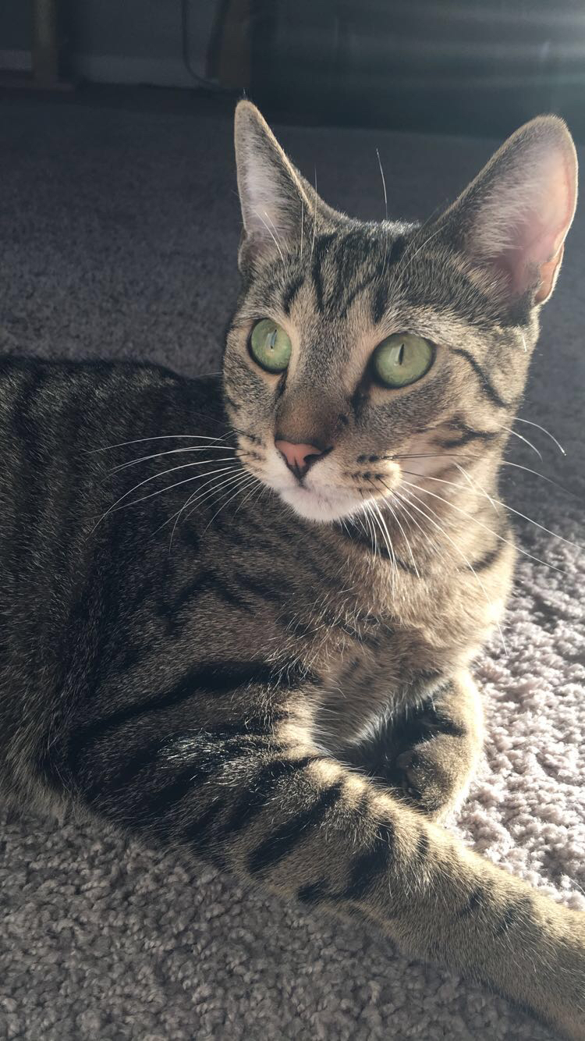
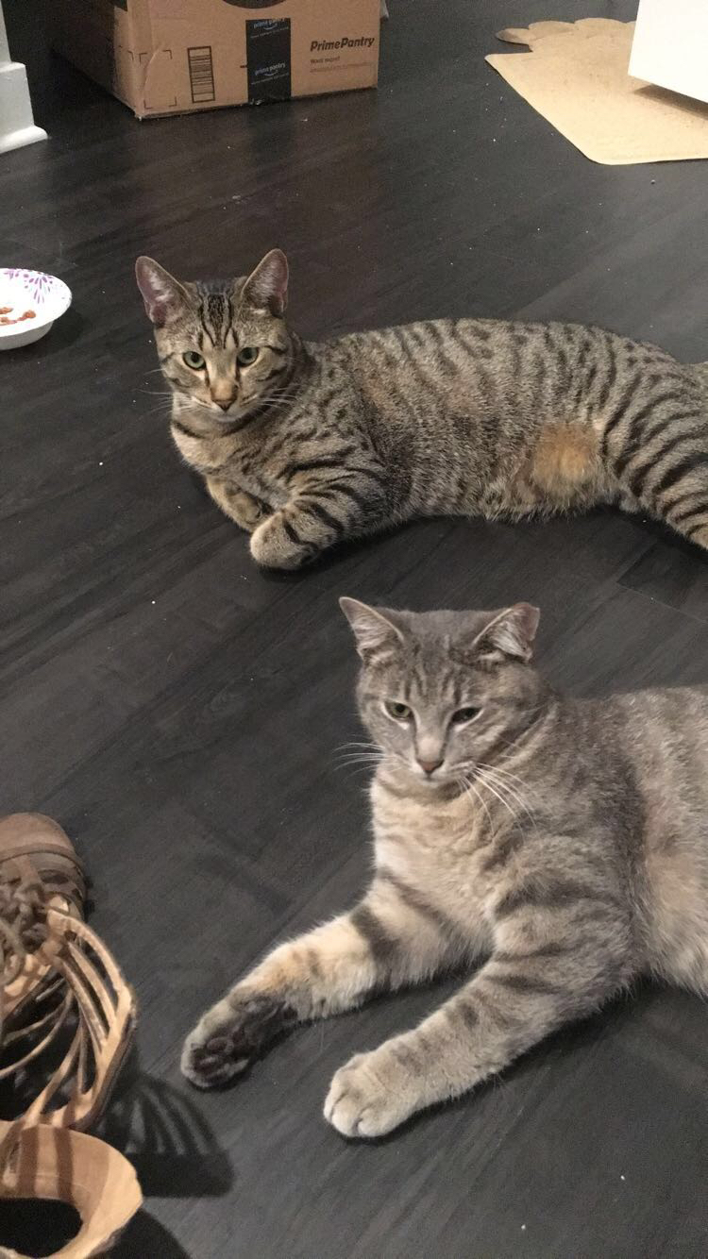
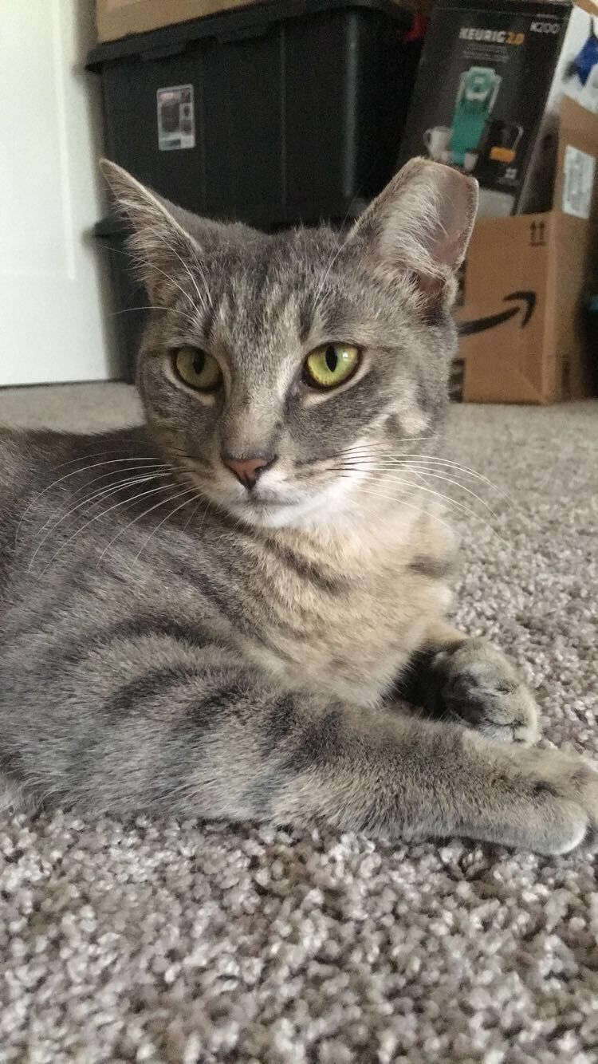
Notes:
Im sure a lot of you have pets I have two cats

Slide 4
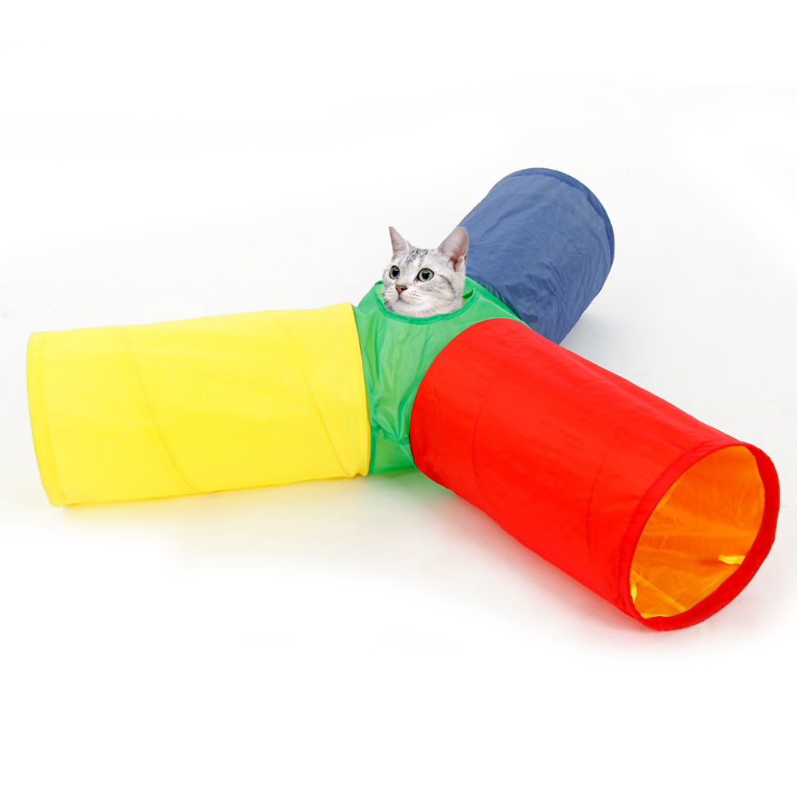
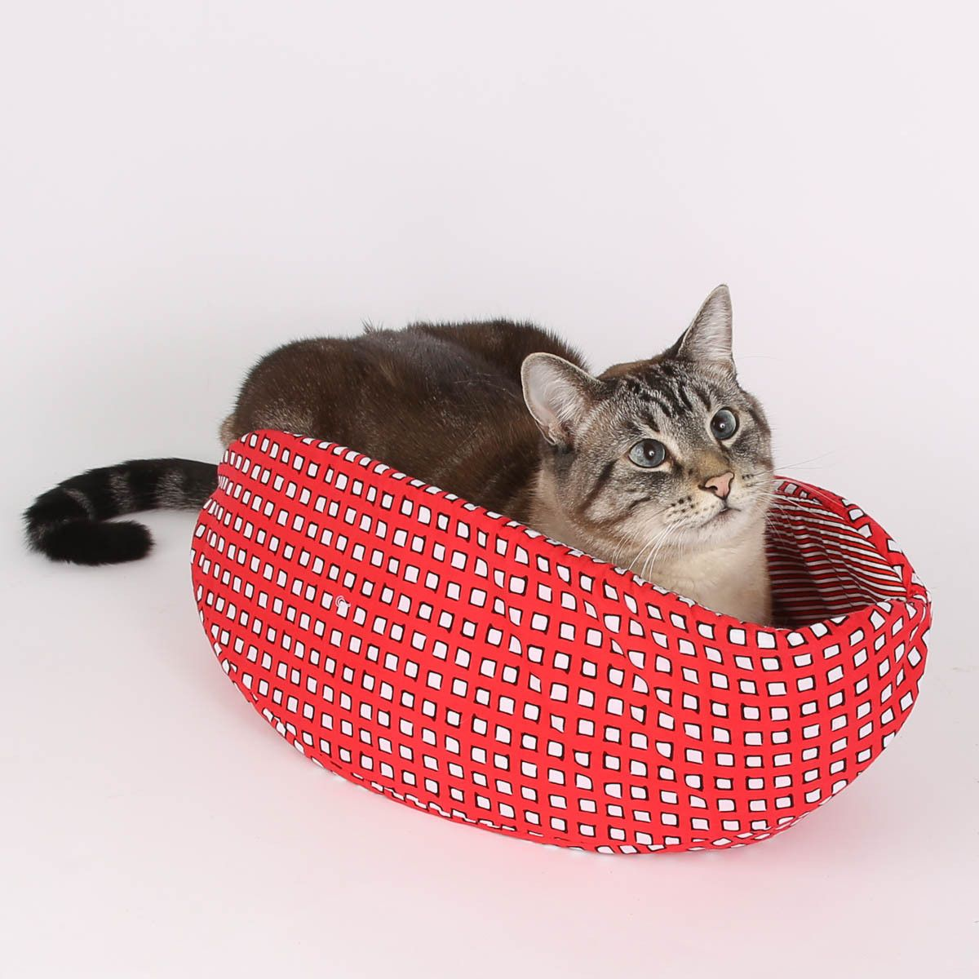
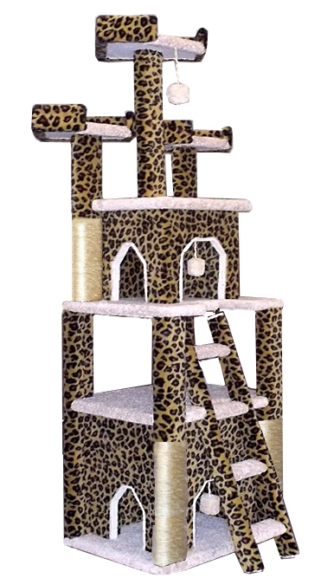
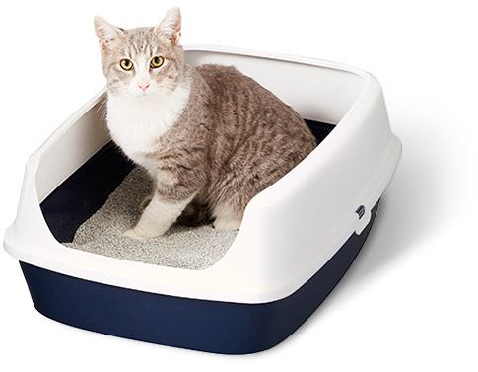
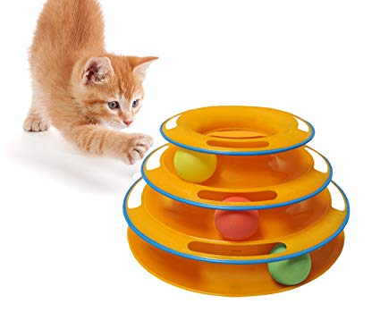
Current State
Notes:
But with my two cats living in a small area also cam a slew of ugly toys and cat condos,

Slide 5
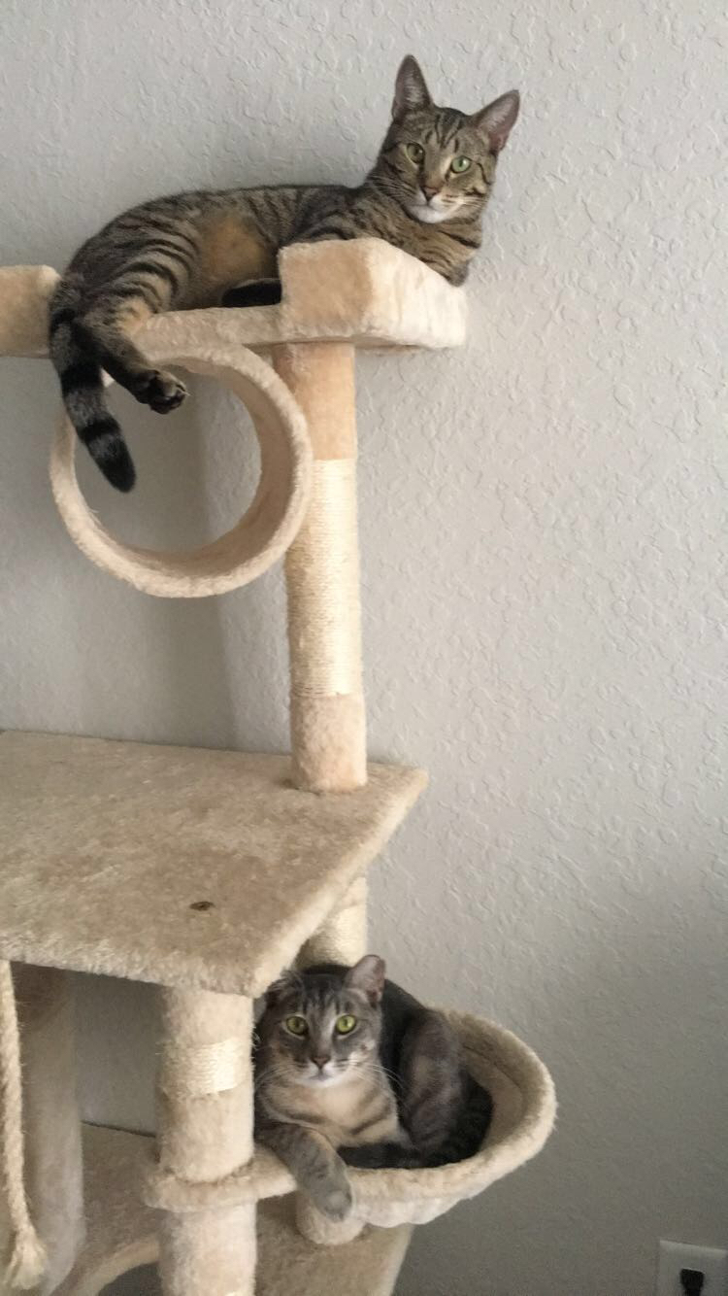
Takes up valuable space
Does not match the decor
Notes:
They look ugly and they take up way to much space, I have cat junk everywhere, so it feels like there is no point in making my décor look when theres cat junk and it wont look good but the cats love it!

Slide 6
There must be a better way to integrate cat products
into the design of the space!
Notes:
Why cant we make products that that aren't ugly and don’t take up space

Slide 7
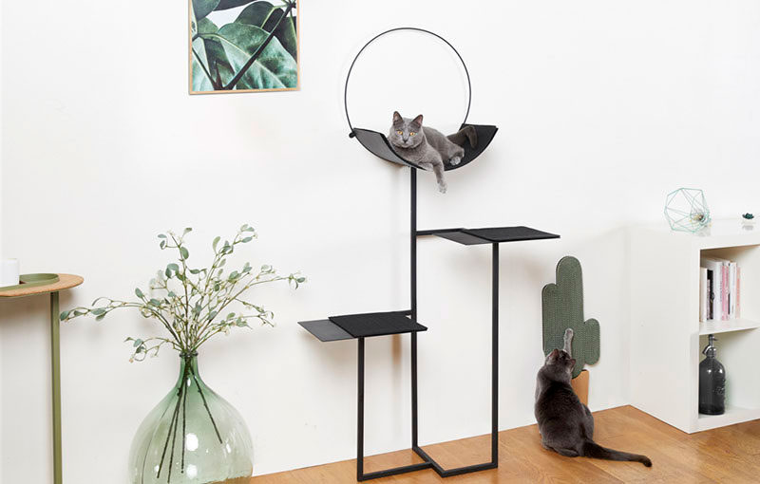
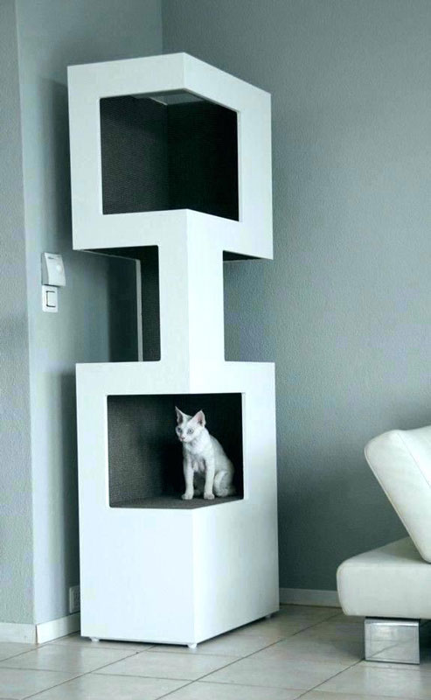
What I learned from my research…
Still takes up space
Limited Selection
Notes:
So I did some research and learned that there is indeed prettier cat furniture but its expensive and for the most part still takes up space

Slide 8
Notes:
And that’s how chateau cat came to be

Slide 9
Client Interview
Size of space
Number of cats in the space
Client’s preferred style
Other needs
Notes:
i interviews a client (my crazy cat lady aunt) on what she wants for a future room design.

Slide 10
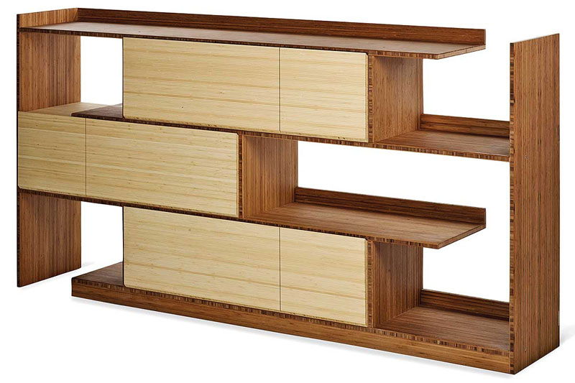
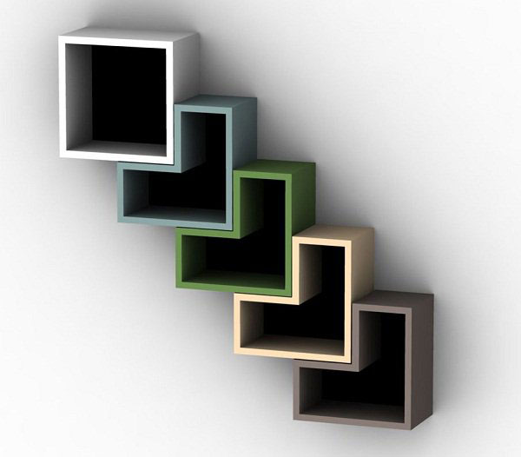
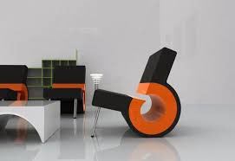
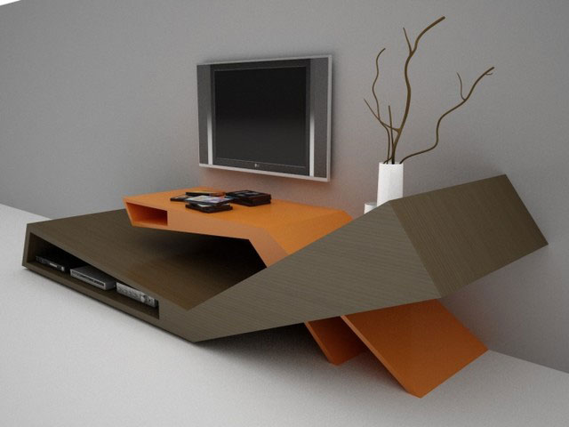
Findings from modern furniture research
Notes:
I styled my furniture designs based off of modern furniture trends

Slide 11
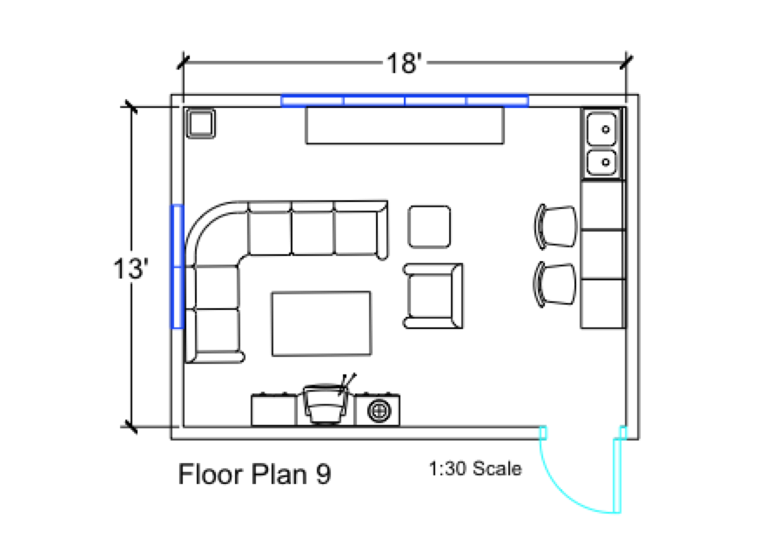
Final Floor Plan
Notes:
I paid special attention making thing that were elegant, durable, functional, cat friendly

Slide 12
Other Necessities:
Elegance
Durability
Functionality
Notes:
I paid special attention making thing that were elegant, durable, functional, cat friendly

Slide 13
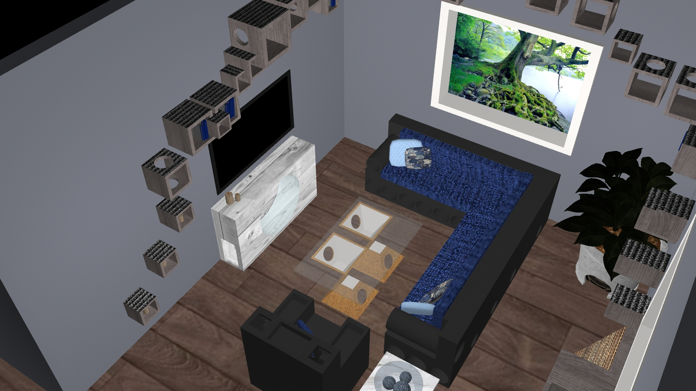
Completed Model in Maya

Slide 14
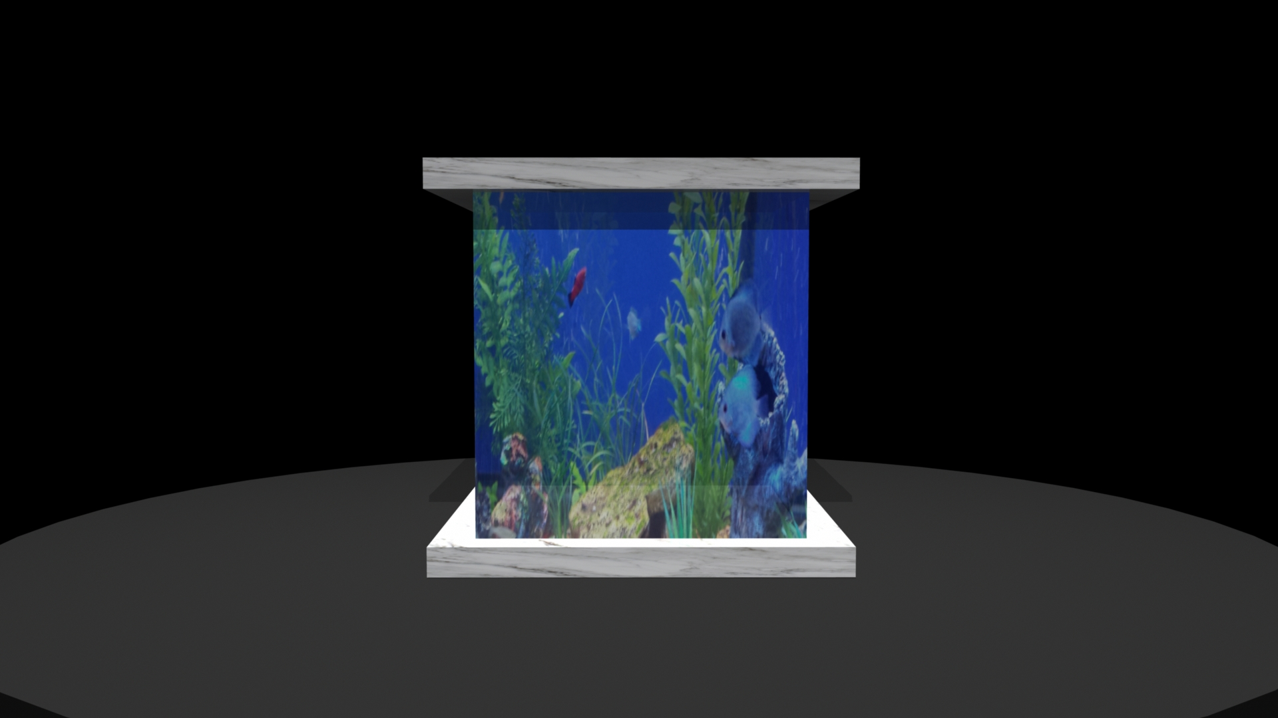
The Curious Cat Side Table

Slide 15
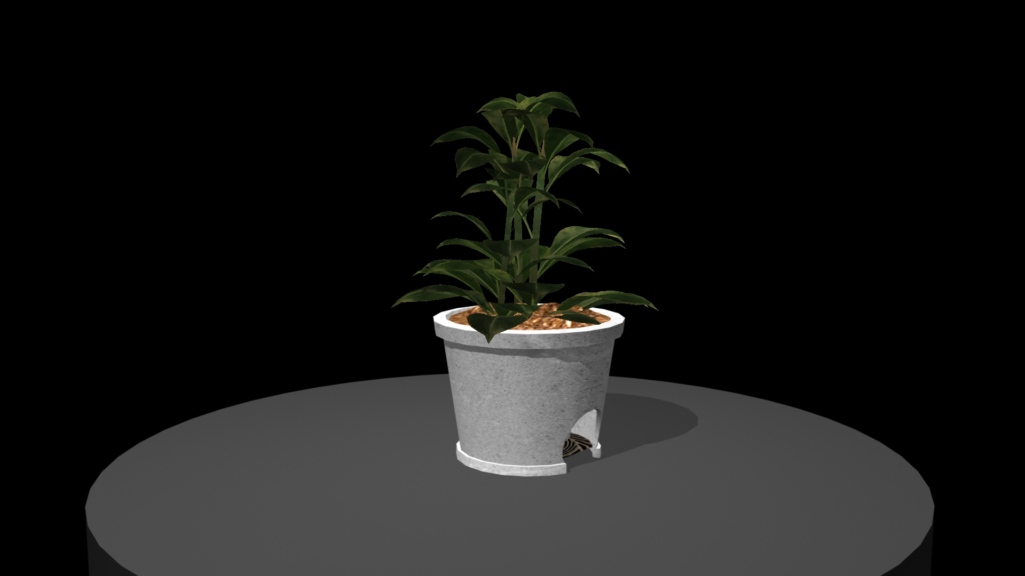
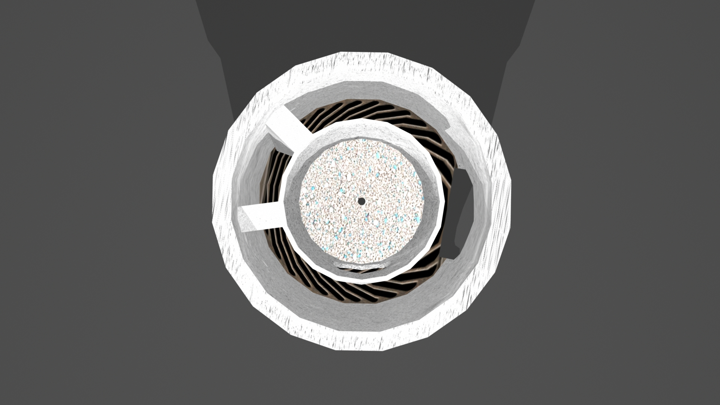
Clean Cat Litter Box

Slide 16
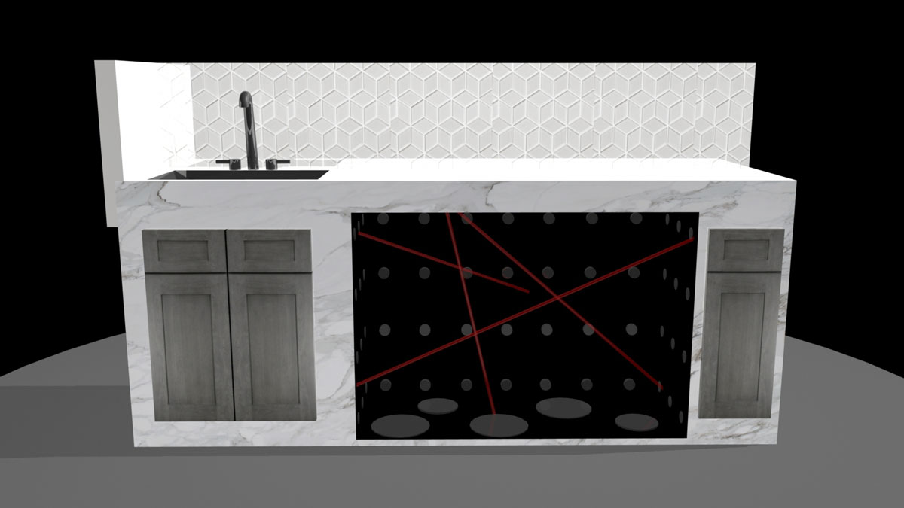
Cavern Cat Bar

Slide 17
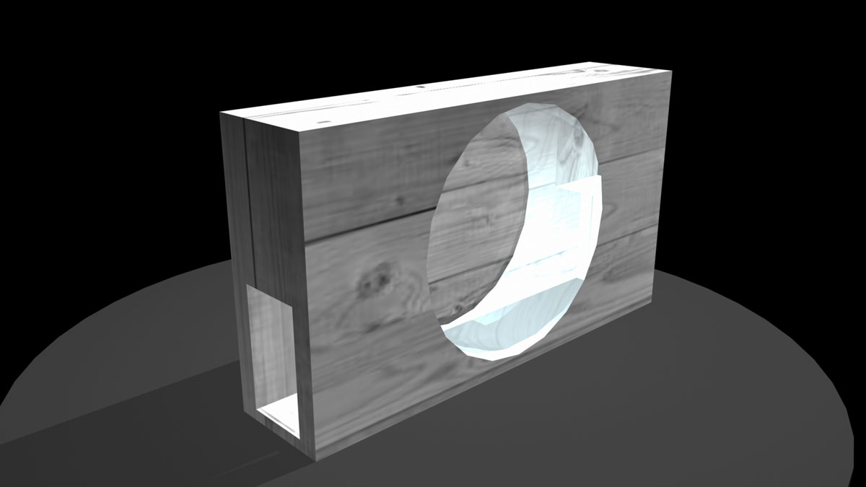
Cardio Cat Wheel

Slide 18
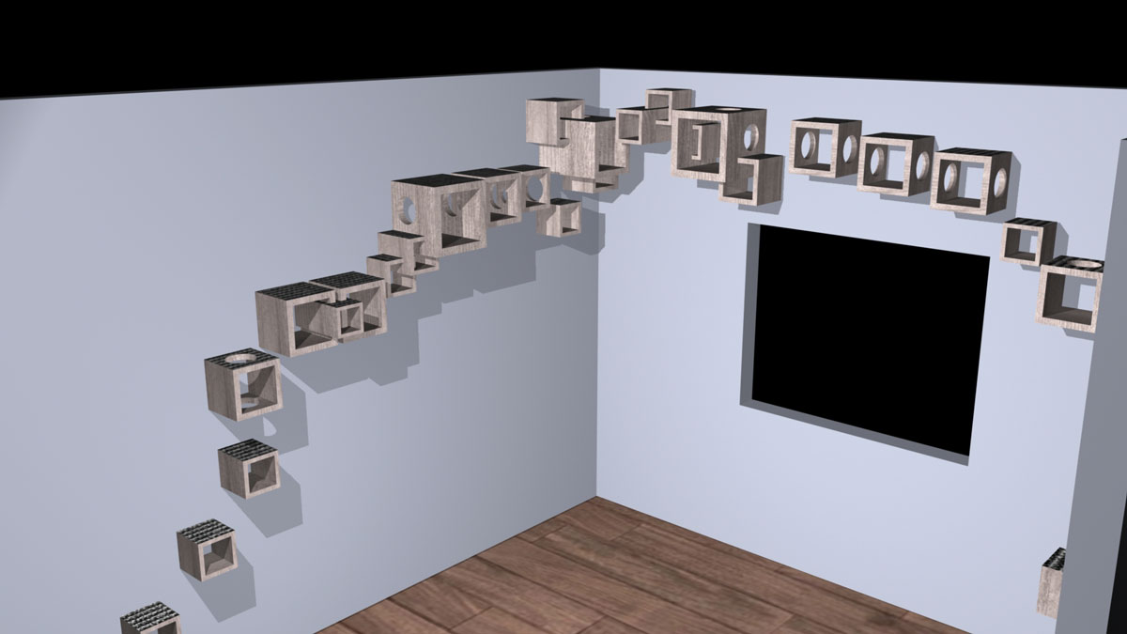
Climbing Cat Wall Decor

Slide 19
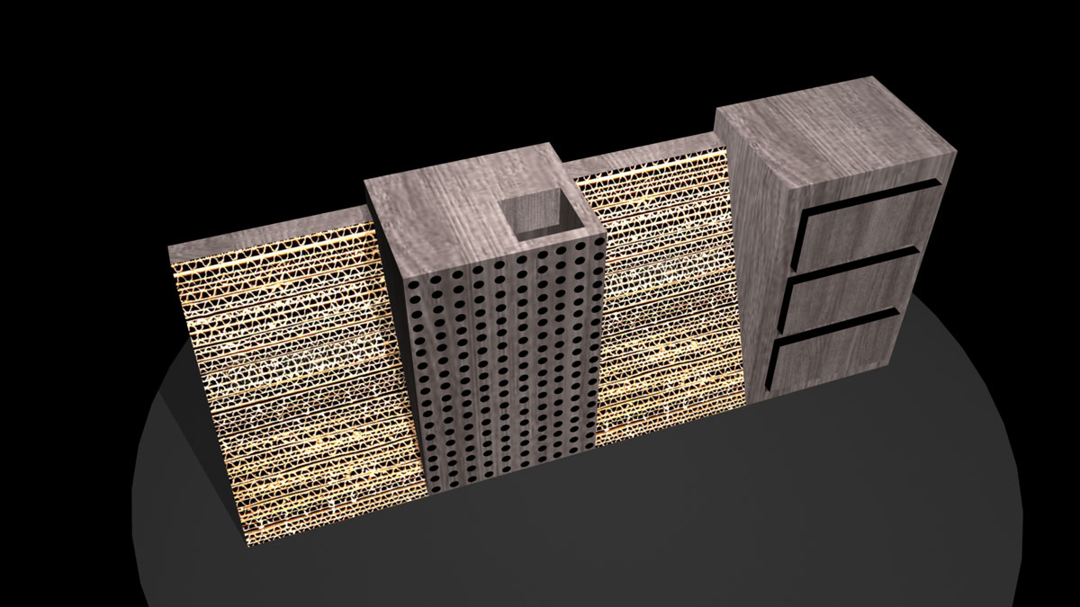
Captivated Cat Console

Slide 20
Software Used to Create the Project
Autodesk AutoCad
Adobe Illustrator
Adobe Photoshop
Autodesk Maya

Slide 21
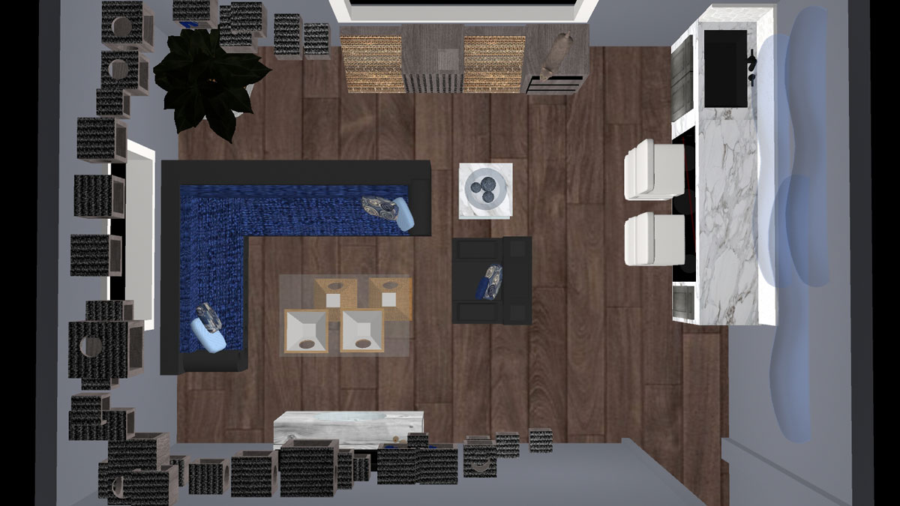
Thank You

